Slide 1

INDUSTRIAL SIMULATION ENVIRONMENT WITH OPEN PLC
DAMIAN ATLSS, CHARLOTTE GLUTTING
Cybersecurity Exam

Slide 2
AGENDA OVERVIEW
01
05
OUR GOALS
PROJECT SIMULATION
02
06
DESIGN INDUSTRY CASE
CYBERATTACKS
03
07
INDUSTRY COMPONENTS SIMULATION
RESULTS
04
08
INFRASTRUCTURE SETUP
SOURCES

Slide 3
OUR GOALS
Simulation of Industrial Environment and Components:
Design and implement a mini-industrial infrastructure to simulate an assembly station.
Integrate components like OpenPLC, Factory I/O, and ScadaBR.
Containerization with Docker:
Use Docker to containerize the simulation to ensure isolation and portability.
Automation with Terraform:
Implement Terraform to automate the provisioning of the infrastructure and enable reproducibility across different deployments.
Security Evaluation:
Evaluate the security of the simulated industrial environment by performing various cyberattacks.
3

Slide 4
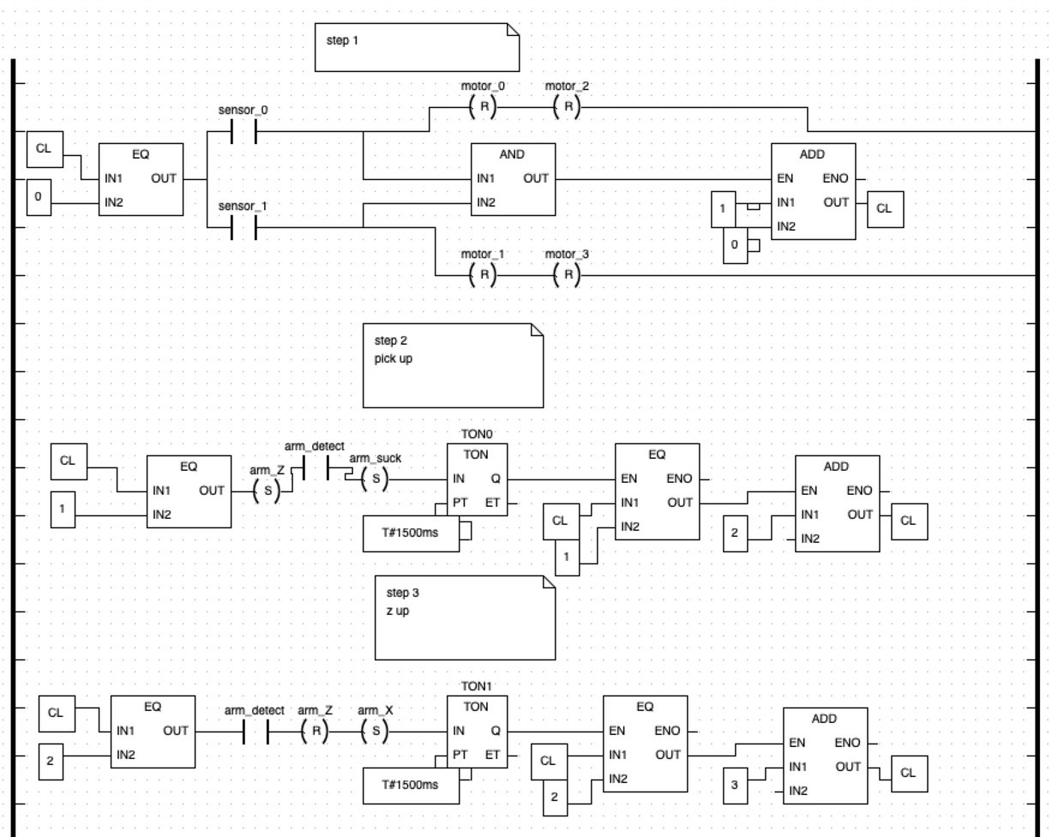
DESIGN INDUSTRY CASE
4

Slide 5
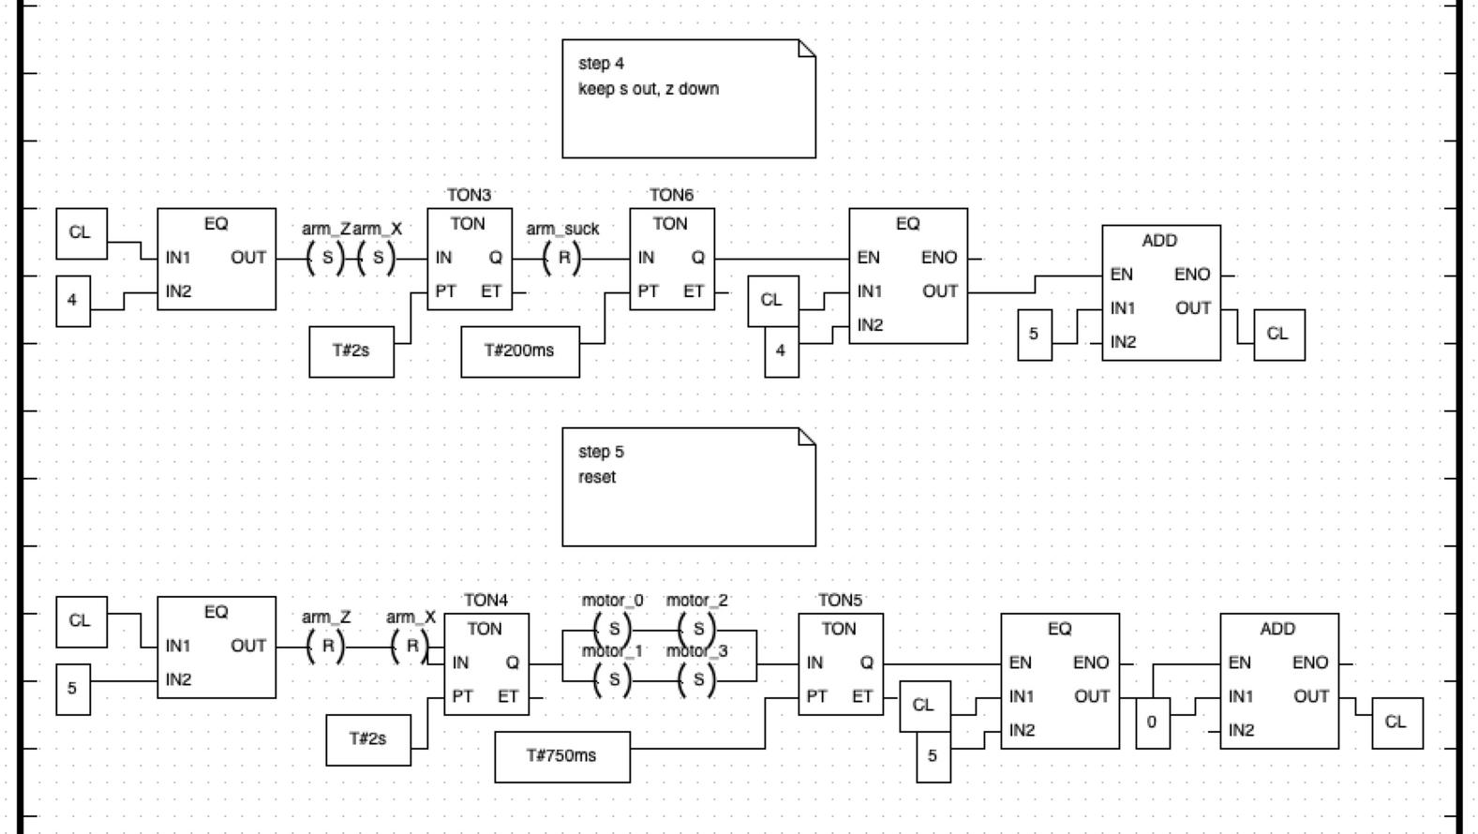
DESIGN INDUSTRY CASE
5

Slide 6
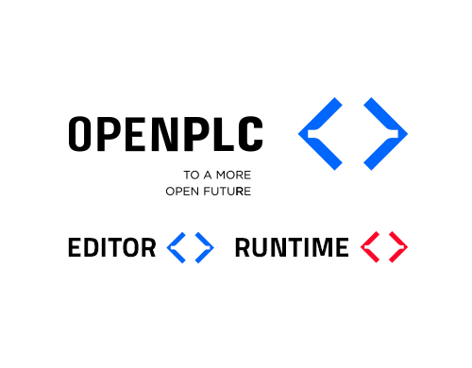

INDUSTRY COMPONENTS SIMULATION
OPEN PLC
Open-source platform for Programmable Logic Controllers (PLCs).
Designed for simulating and controlling industrial automation components.
OpenPLC Runtime: Executes PLC programs and handles real-time industrial control and simulation.
OpenPLC Editor: Provides a user-friendly interface to create and edit PLC programs.
FACTORY I/O
Provides a dynamic 3D simulation environment for testing PLC programs.
Complements OpenPLC for a full simulation and control workflow.
6

Slide 7
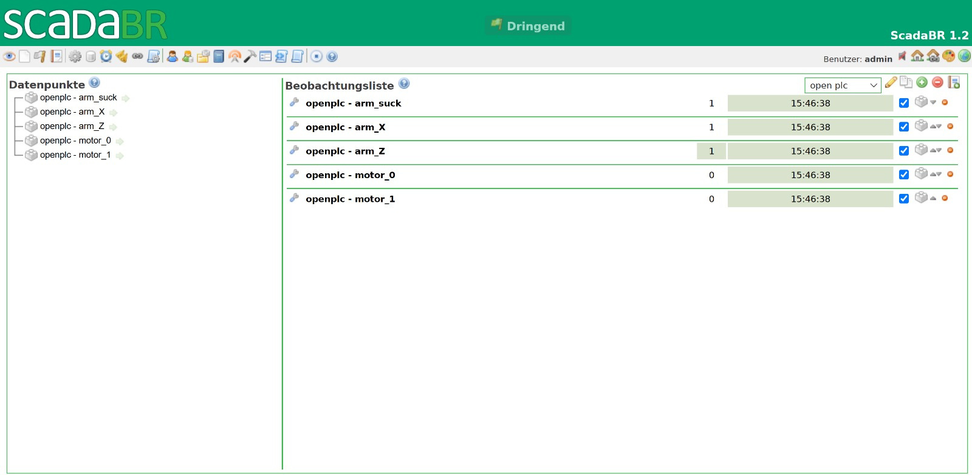
INDUSTRY COMPONENTS SIMULATION
SCADA BR
Open-source Supervisory Control and Data Acquisition (SCADA).
Serves as the Human-Machine Interface (HMI) for monitoring and controlling industrial processes.
Provides a user-friendly interface to monitor real-time data.
7

Slide 8
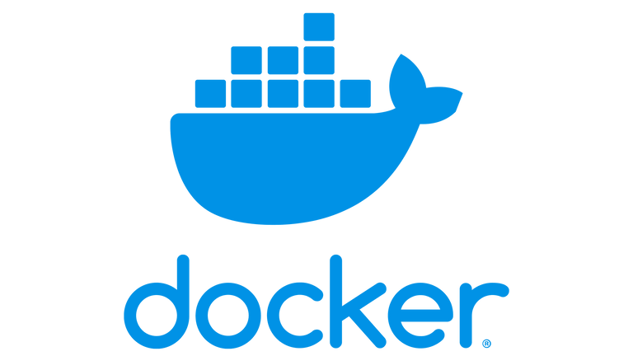

INFRASTRUCTURE SETUP
CONTAINERIZATION AND NETWERK
Provides isolated containers for applications and their dependencies.
Network ensures containers can communicate with each other.
Use Cases in Our Project: Running OpenPLC Runtime and ScadaBR and simulating cyberattacks.
INFRASTRUCTURE AS CODE
For automating resource management.
Used to provision Docker components.
Simplifies Docker infrastructure management.
Enhances scalability and reproducibility of our project environments.
8

Slide 9
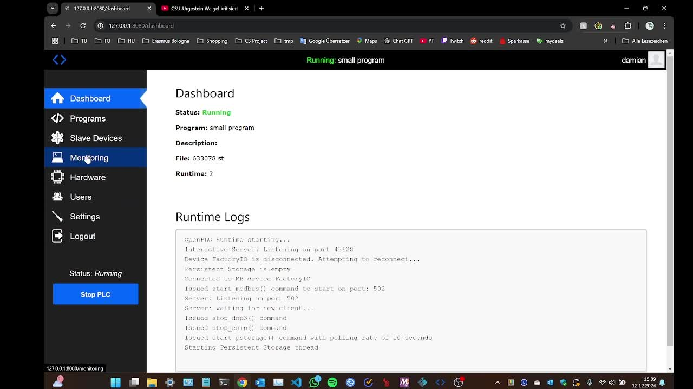
PROJECT SIMULATION
9

Slide 10
CYBERATTACKS
DDoS (Distributed Denial of Service):
Overwhelms the OpenPLC system with excessive traffic to cause disruptions in normal operations and make it unresponsive to legitimate requests.
HTTP Flood:
Targets the OpenPLC web interface by simulating a large number of login attempts to prevent legitimate users from accessing the system.
MITM (Man-in-the-Middle):
Intercepts and manipulates communication between OpenPLC and ScadaBR to allow attackers to alter data or inject malicious commands without detection.
Modbus Flooding:
Exploits the Modbus communication protocol by sending a flood of illegitimate requests to the OpenPLC system to disrupt its ability to process valid commands and responses.
10

Slide 11
RESULTS
Simulation Success:
Successfully simulated an assembly station integrating OpenPLC, Factory I/O, and ScadaBR.
Utilized two versions of OpenPLC: one running locally and another in Docker containers.
Containerization with Docker achieved:
Docker used to containerize all components, ensuring isolation and portability.
Docker networking enabled seamless communication between OpenPLC and ScadaBR.
Automation achieved:
Terraform fully automated infrastructure provisioning, ensuring consistency and reproducibility.
Security Testing Outcome:
Conducted DDoS, HTTP Flood, MITM, and Modbus Flooding attacks.
Attacks were unsuccessful because of their simple nature and to robust network configurations.
11

Slide 12
SOURCES
https://docs.factoryio.com, 13.12.24.
https://github.com/ScadaBR, 13.12.24.
https://docs.docker.com/get-started/docker-overview/, 13.12.24.
https://docs.docker.com/engine/network/, 13.12.24.
https://www.cloudflare.com/de-de/learning/ddos/ddos-attack-tools/how-to-ddos/, 13.12.24.
https://owasp.org/www-community/attacks/Manipulator-in-the-middle_attack.com, 13.12.24.
https://dl.acm.org/doi/pdf/10.5555/2667510.2667517, 13.12.24.
https://autonomylogic.com/docs/openplc-overview/, 13.12.24.
https://www.terraform.io/, 13.12.24.
12

Slide 13
THANK YOU FOR YOUR ATTENTION
Cybersecurity Exam
13

